Slide 1
Acknowledgements
I, Sandip Gujar - a student at Simplilearn, thank all the staff of Simplilearn for extending full support and co-ordination in my endeavor of following the “Data Scientist Course” through the Simplilearn LMS.
In this strive, while learning “Tableau Desktop 10 qualified Associate”, the trainer Mr. Ramanathan Somasundaram taught us, guided us and mentored us wonderfully. He has been kind to cooperate and help. This project has come through, because of his excellent teaching and concept clearing skills.
Mr. Ramanathan’s knowledge on Tableau is excellent and simply superb. I wish him the best for his future goals and achievements.
I convey my gratitude to Simplilearn, Mr. Ramanathan and all staff members of Simplilearn.

Slide 2
Project 2 – SALES PERFORMANCE ANALYSIS
Objective :-
To Measure the Sales performance of Products in various categories and segments for better decision making . Decision to be taken on whether to continue or discontinue the product considering whether the product has met, exceeded or not met the sales target through comparative analysis across years.
Data sets available for analysis :-
Sample – Superstore
Sales Target
Approach to be taken :-
If we have got a goal and want to track progress against it, then “BULLET CHARTS” play vital key role in analysis.
Bullet charts are variation of bar charts.
Very Informative & Insightful, when it comes to evaluating a metric performance against a goal.

Slide 3
Analysis Tasks :-
Connecting “Sample Superstore” as Primary source and added new data source “Sales Target” as Secondary data Source.
Added Sales Measures from both data sources and Category in “Columns” & Segment and Month Discrete into “Rows”. Clicked on Show Me and selected option as “Bullet Chart” and did visual adjustments by transposing it.
Created Calculated field as “Sales above Budget?” with If Else statements to provide sales which are above target and edited in color options as Green and Red.
Added Order date into Filters and selected Use all options and activated it.
Created Dashboard and kept screen on Automatic. Changed Tiled to floating screen and imposed both filters on sheet.

Slide 4
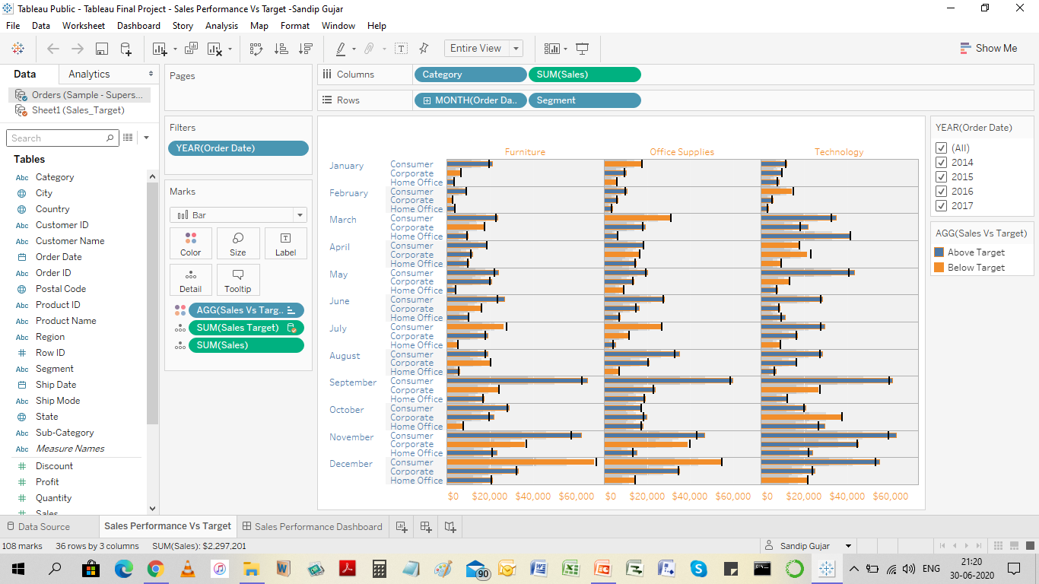
1. Connecting “Sample Superstore” as Primary source and added new data source “Sales Target” as Secondary data Source.

Slide 5
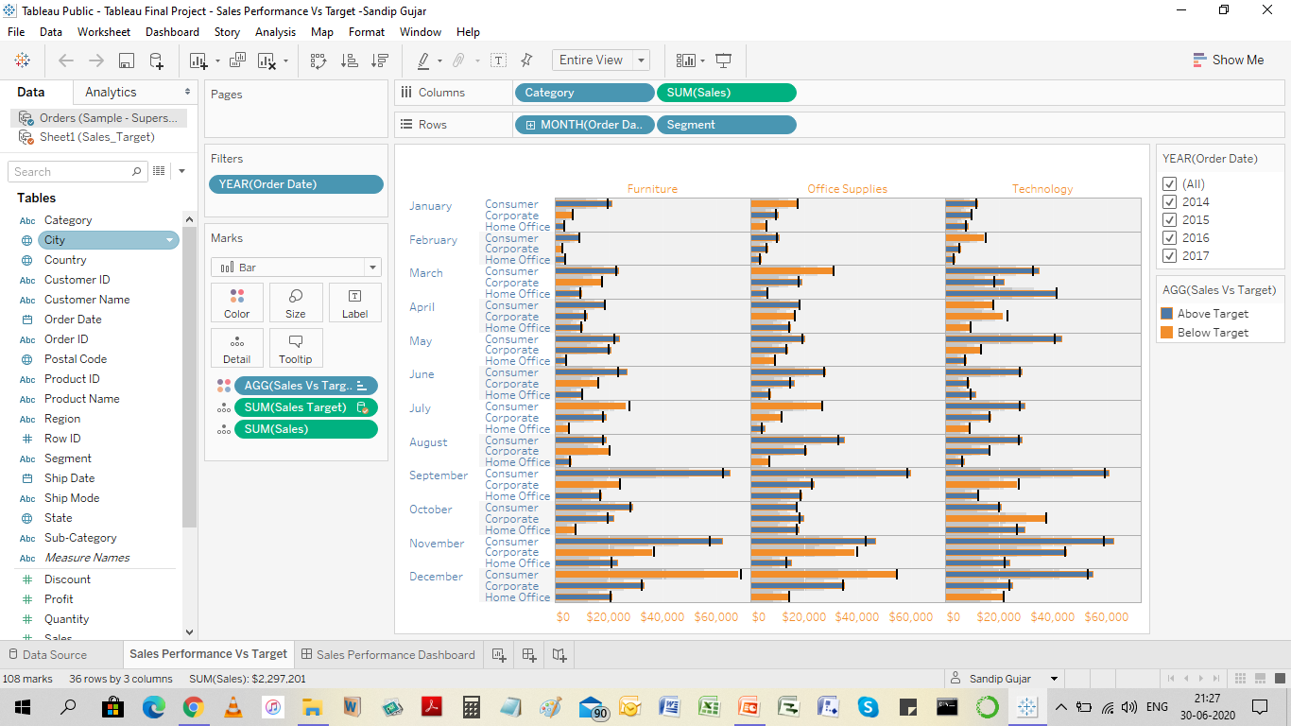
2.Added Sales Measures from both data sources and Category in “Columns” & Segment and Month Discrete into “Rows”. Clicked on Show Me and selected option as “Bullet Chart” and did visual adjustments by transposing it.

Slide 6
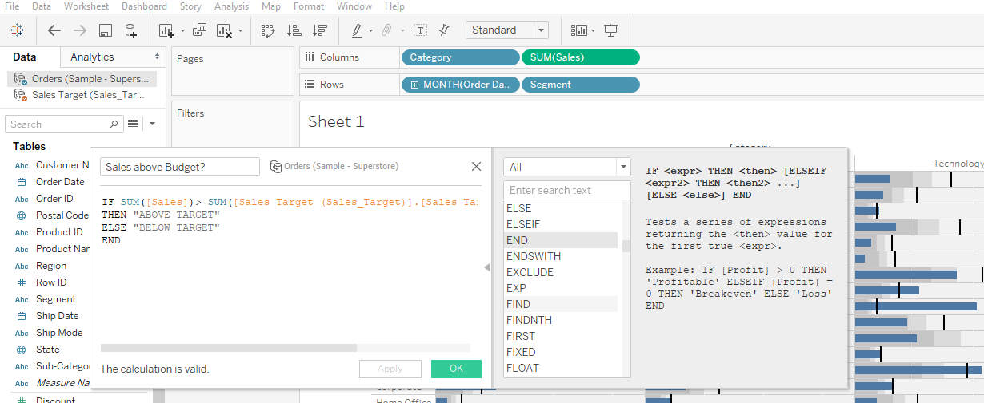
3. Created Calculated field as “Sales above Budget?” with If Else statements to provide sales which are above target and edited in color options as Green and Red.

Slide 7
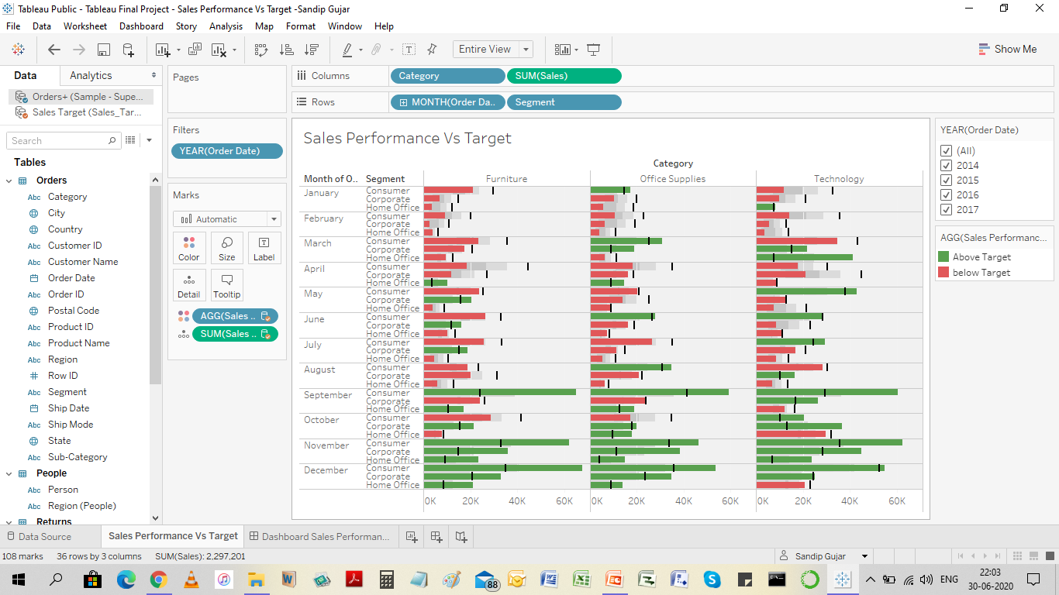
4.Added Order date into Filters and selected Use all options and activated it.

Slide 8
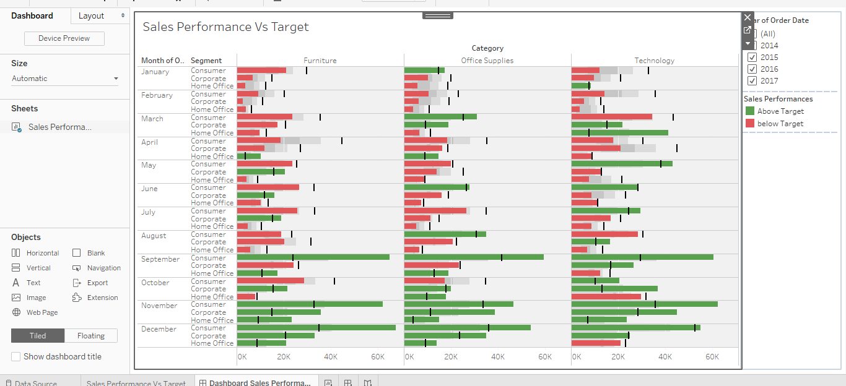
Created Dashboard and kept screen on Automatic. Changed Tiled to floating screen and imposed both filters on sheet.

Slide 9
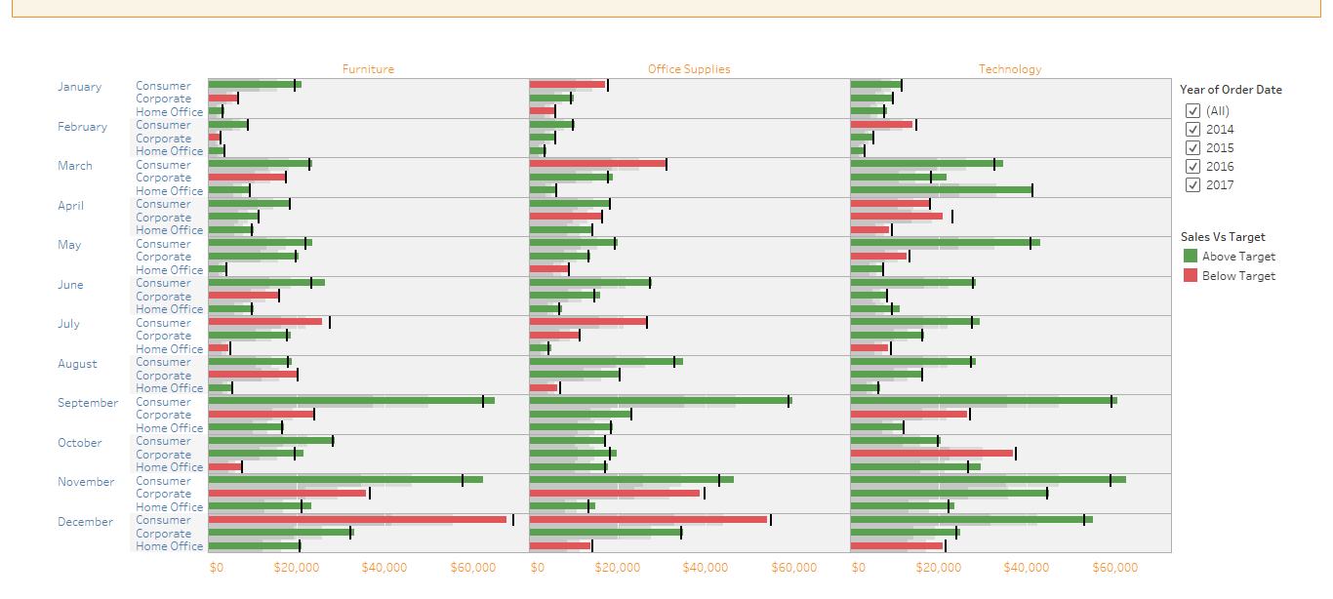
Final Output
End of Project

